Slide 1

Forget ODBC! Here’s a New Db2 Connector
Jonathan Zak
Staff Software Engineer
Jonathan.Zak@ibm.com
Sanjula Ganepola
Software Developer
Sanjula.Ganepola@ibm.com
2025 February

Slide 2
Agenda
Mapepire Overview
Architecture and Core Tenets
Comparisons versus JDBC and ODBC
Deep dive into the Java client SDK
Demo

Slide 3
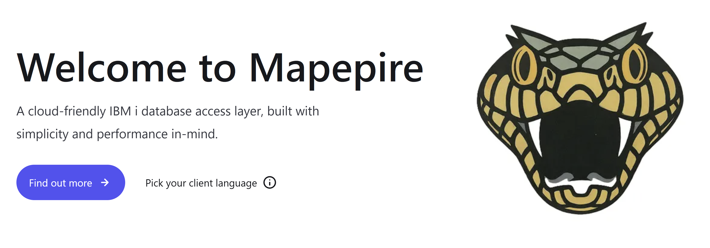

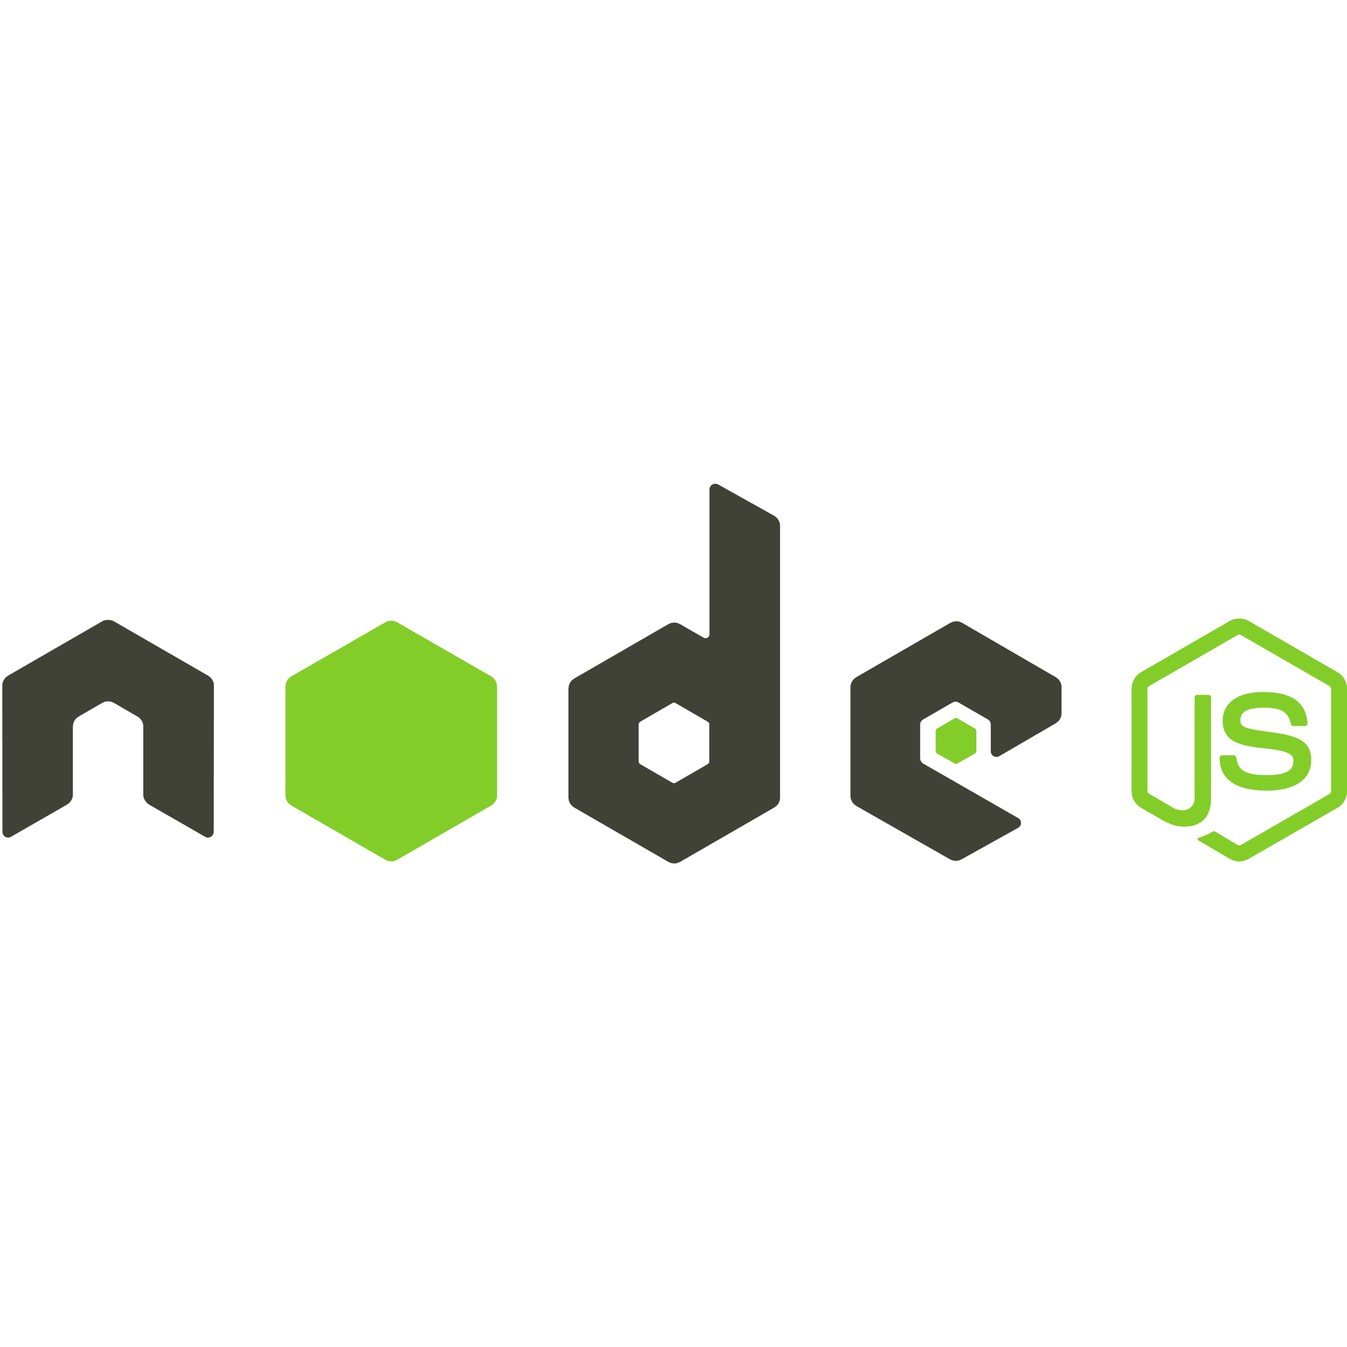



What is Mapepire?
Super easy to use way to access Db2 for i from any application

Slide 4
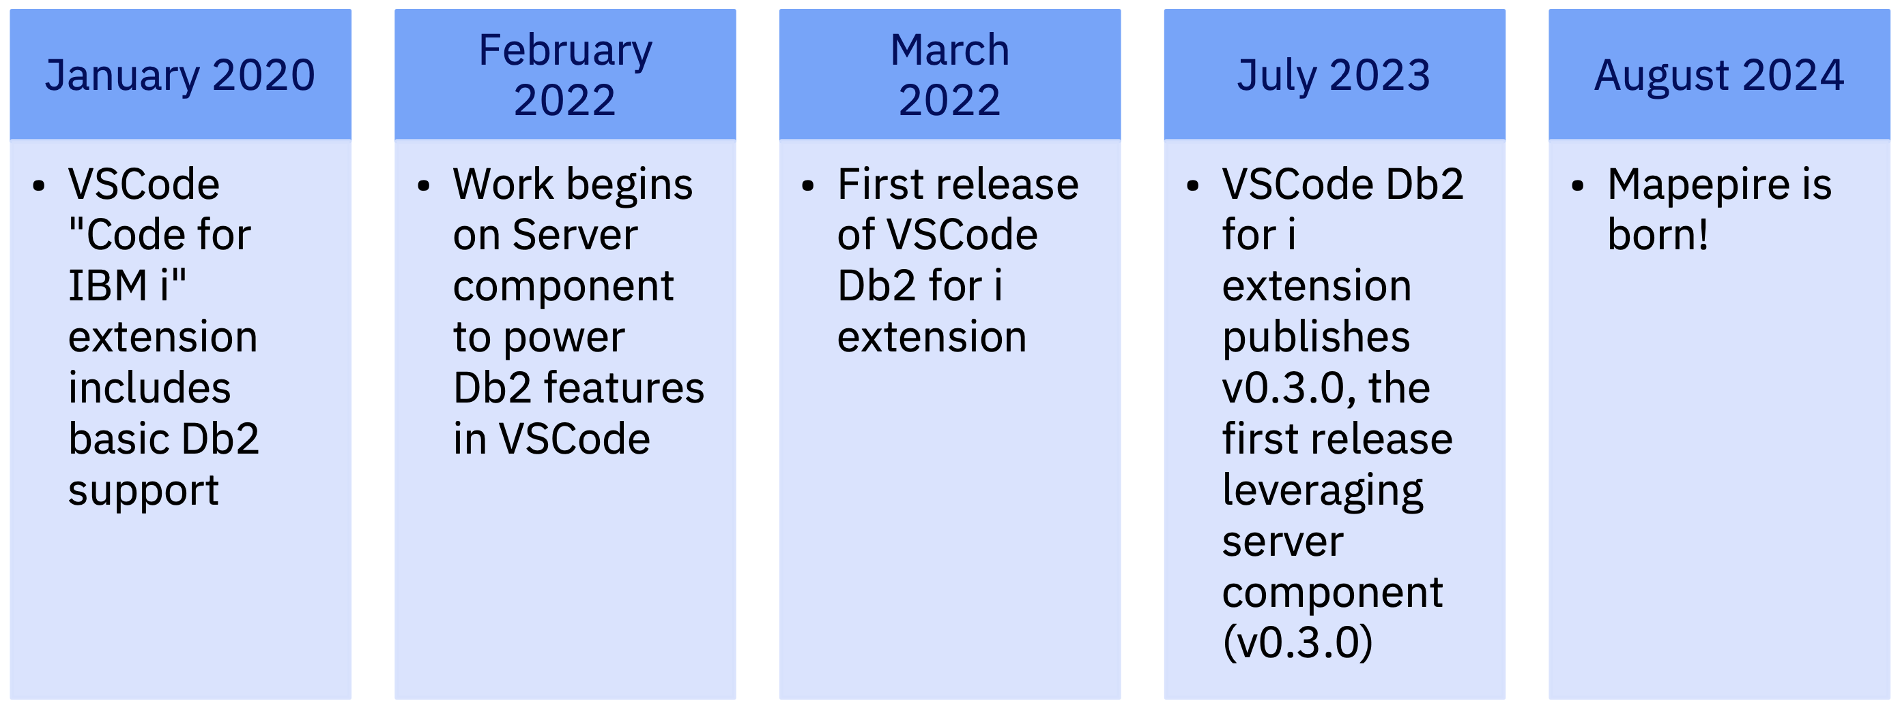



Mapepire Origin Story…

Slide 5
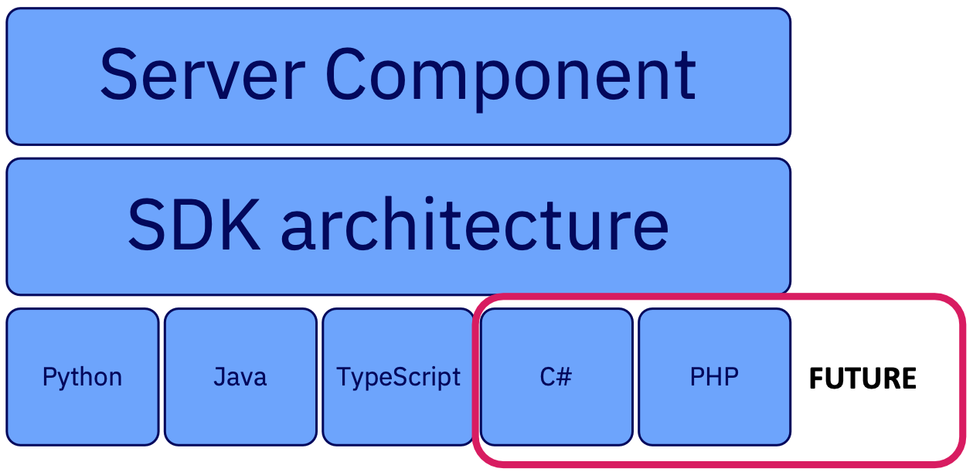
Mapepire Components

Slide 6
How does it work?
Connect to Database
Communication over secure web sockets
{
"id": "id2",
"type": "connect",
"technique": "tcp",
"application": "Java client"
}
👨🏻‍💻 Application
🤖
Server Component
IBM i
{
"id": "id2",
"job": "112480/QUSER/QZDASOINIT",
"success": true
}
Application uses Mapepire client SDK
Managed using Service Commander

Slide 7
How does it work?
Query the Database
Request
Response
{
"id": "query3",
"has_results": true,
"update_count": -1,
"metadata": {
"column_count": 1,
"job": "112480/QUSER/QZDASOINIT",
"columns": [
{
"name": "DEPTNO",
"type": "CHAR",
"display_size": 3,
"label": "DEPTNO",
"precision": 3,
"scale": 0
}
]
},
"data": [
{
"DEPTNO": "A00"
}
],
"is_done": true,
"success": true
}
{
"id": "query3",
"type": "sql",
"sql": "SELECT DEPTNO FROM SAMPLE.DEPARTMENT WHERE DEPTNO = 'A00'",
"terse": false,
"rows": 100
}

Slide 8
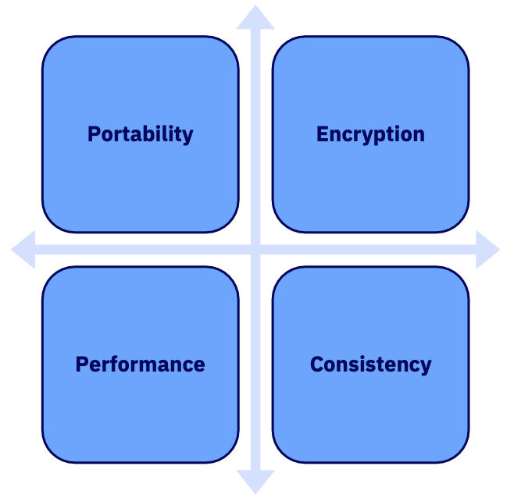
Core Tenets

Slide 9
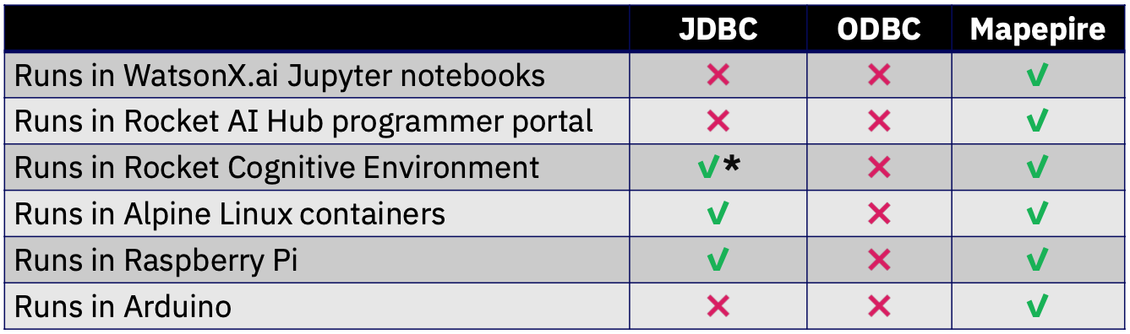
The biggest benefit of Mapepire.... Portability!!

Slide 10
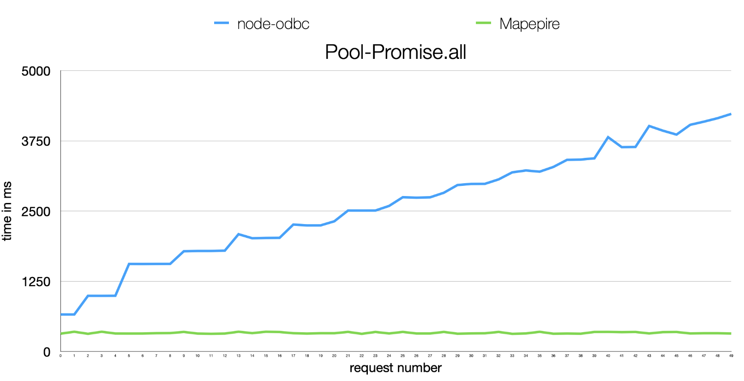
Some performance comparisons

Slide 11
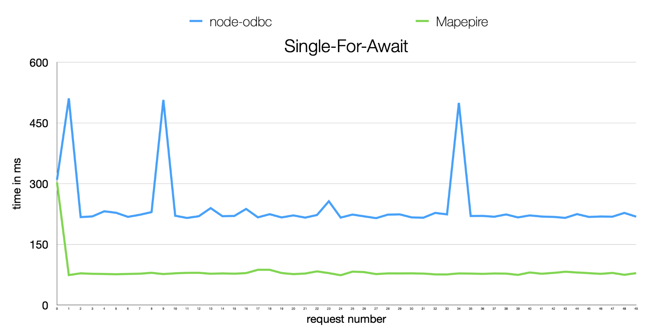
Some performance comparisons

Slide 12
How to encrypt data with JDBC/ODBC
Log into DCM
Create a local certificate authority (CA) store
Create a local CA certificate
Record the value of the auto created CA label
Create the *SYSTEM certificate store (if needed)
Create a new server certificate
Sign the server certificate with your local CA
Assign new server certificate to host server applications
Restart Host Servers
On client, download the server's certificate authority to a local trust store (or configure TLS to ignore completely)

Slide 13
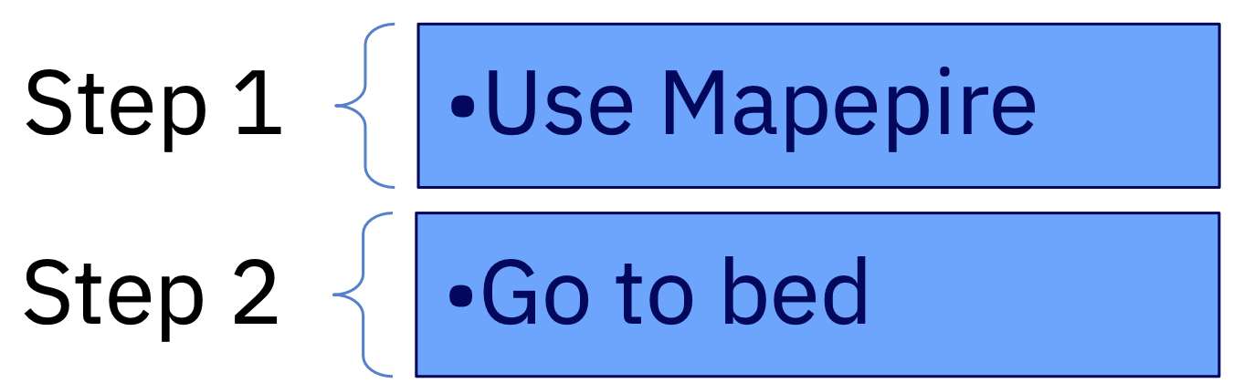
How to encrypt data with Mapepire?

Slide 14
How does Mapepire make it so easy?
Option 1: Custom certificate
Admin explicitly defined a custom certificate by configuring a certificate store:
File name: /QOpenSys/etc/mapepire/cert/server.jks
Format: JKS
Store Password: mapepire
Key Password: mapepire
Certificate Alias: mapepire
Check out documentation for full instructions: https://mapepire-ibmi.github.io/guides/sysadmin/
Option 2: Let's Encrypt
Use Let's Encrypt (ex. generated by CertBot)
Mapepire server will automatically use it as the server certificate
Certificate must exist in the following location used by CertBot: /etc/letsencrypt/live/<hostname>
Option 3: Self-signed certificate
If no certificate, the server automatically generates its own self-signed certificate

Slide 15
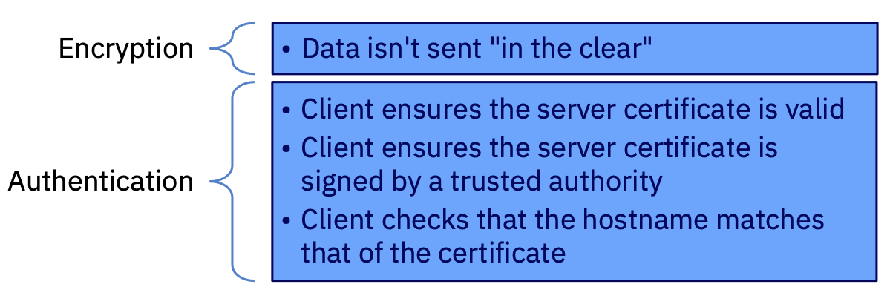
What does TLS provide?

Slide 16
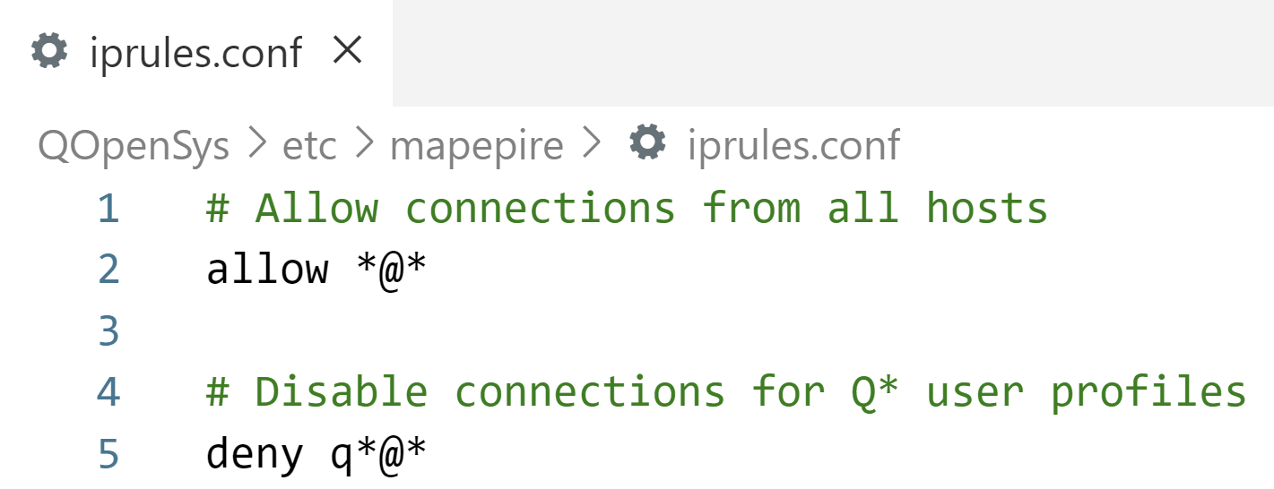
User profile and IP filtering
/QOpenSys/etc/mapepire/iprules.conf can be used govern which user profiles and IP addresses are able to connect

Slide 17
Mapepire's back-end is JDBC
Mapepire is an interface in front of JTOpen and JDBC
Mapepire utilizes QZDASOINIT or, more likely, QZDASSINIT (S = "secure") jobs
All considerations for ODBC/JDBC server job scalability and security still apply
Object authority still applies
Any ODBC/JDBC exit points will still work to control traffic and access

Slide 18
How to manage the JDBC workload?
By default, all QZDASOINIT/ QZDASSINIT jobs run in QUSRWRK
Questions:
How to control out-of-control queries from query tools?
How to know which application is using up resources?
How to let critical users get the resources they need while not letting long queries take over the system?
How to manage your JDBC jobs more effectively?

Slide 19
Separate jobs by application, user, etc.
Configure your QZDASSINIT jobs to run in separate subsystems, based on your criteria
JDBCSHOP
JDBCADHOC
JDBCNODE
Then performance "waits" can be aggregated by subsystem and you can configure memory, etc. per subsystem
Easier troubleshooting as JDBC jobs from different applications will not interact
Also limit with these techniques https://www.ibm.com/support/pages/setting-limitations-resources-used-qzdasoinit-prestart-jobs
Details: https://www.seidengroup.com/2022/05/04/simplify-with-subsystems/

Slide 20
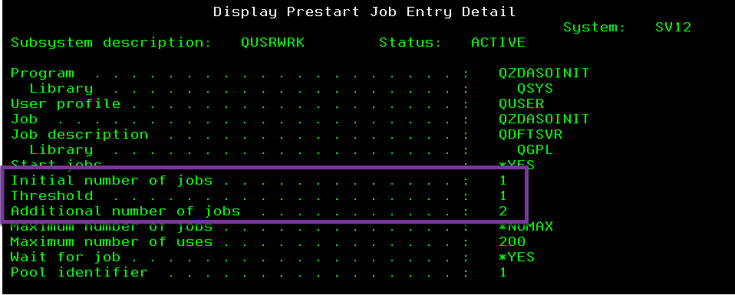
Configure JDBC Prestart jobs
Configure the right number of prestart jobs
– ODBC/JDBC prestart jobs are QZDASO(S)INIT in QUSRWRK
Check out your current configuration:
– DSPSBSD SBSD(QUSRWRK)
– Choose 10, Prestart job entries
– Type 5 next to QZDASOINIT

Slide 21
Default ODBC/JDBC prestart job settings
Low defaults
Initial jobs = 1, threshold = 1, additional jobs = 2
Change as needed:
CHGPJE SBSD(QSYS/QUSRWRK) PGM(QSYS/QZDASOINIT)
STRJOBS(*YES) INLJOBS(xx) THRESHOLD(xx)
ADLJOBS(xx)
How to determine optimal values? DSPACTPJ (coming up)

Slide 22
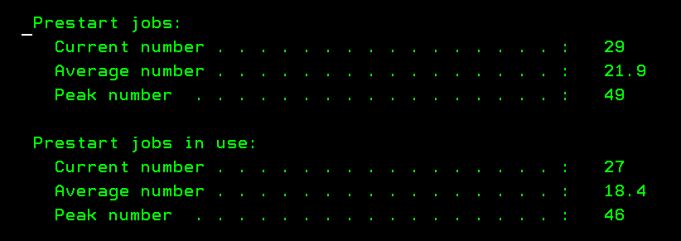
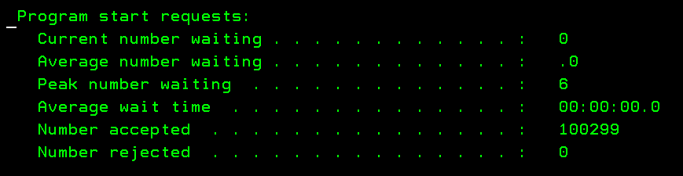
How many jobs are needed?
DSPACTPJ SBS(QUSRWRK) PGM(QZDASOINIT)
More details: https://www.ibm.com/docs/en/i/7.4?topic=jobs-tuning-prestart-job-entries

Slide 23
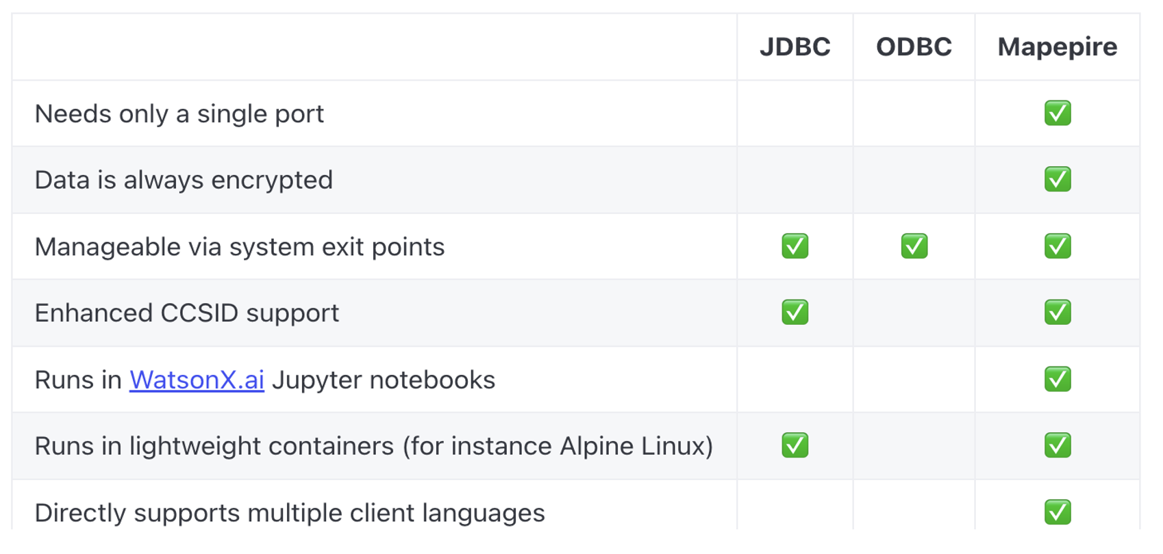
JDBC vs ODBC vs Mapepire

Slide 24
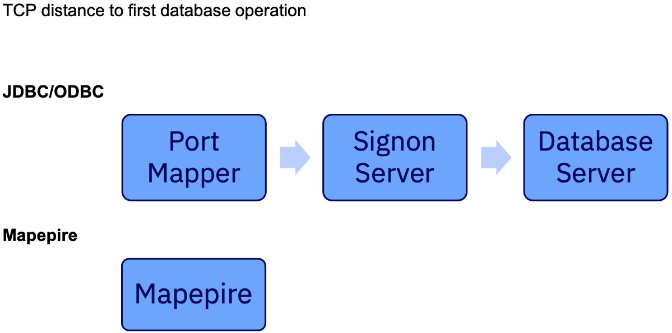
Single port? Big deal!

Slide 25
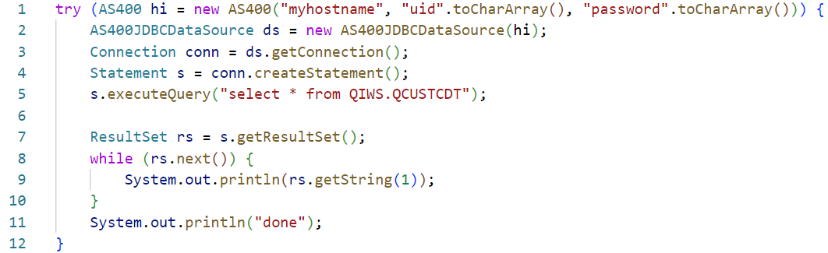
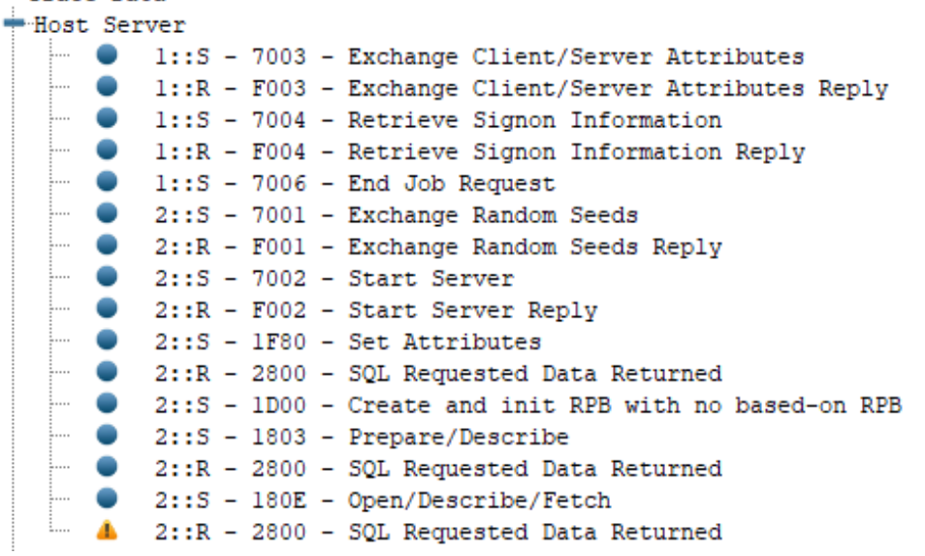
Distinct TCP flows for a JDBC program!!
Meanwhile….
✨ Mapepire only needs 2 TCP flows
Connect and allocate a job
Run a query

Slide 26
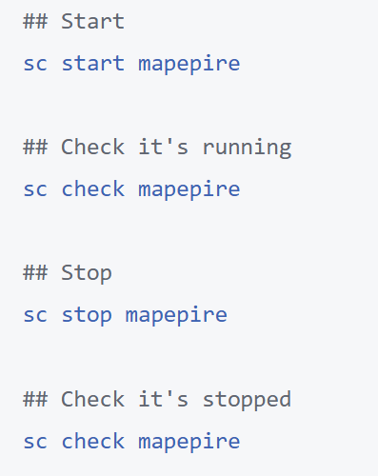
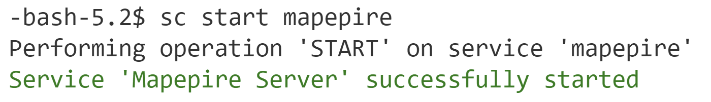
Mapepire server setup
Install the Mapepire server component: yum install mapepire-server
Install Service Commander: yum install service-commander
Launch mapepire: sc start mapepire

Slide 27
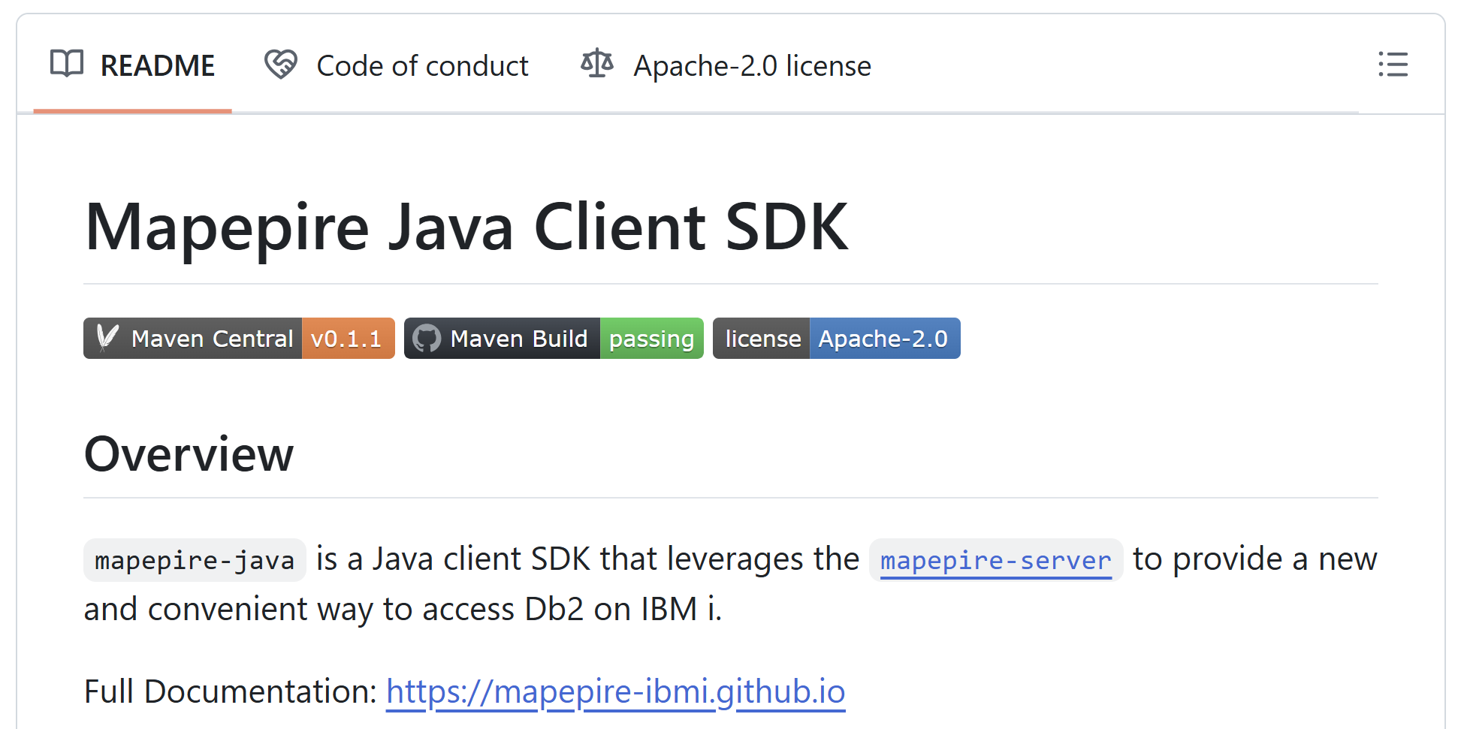
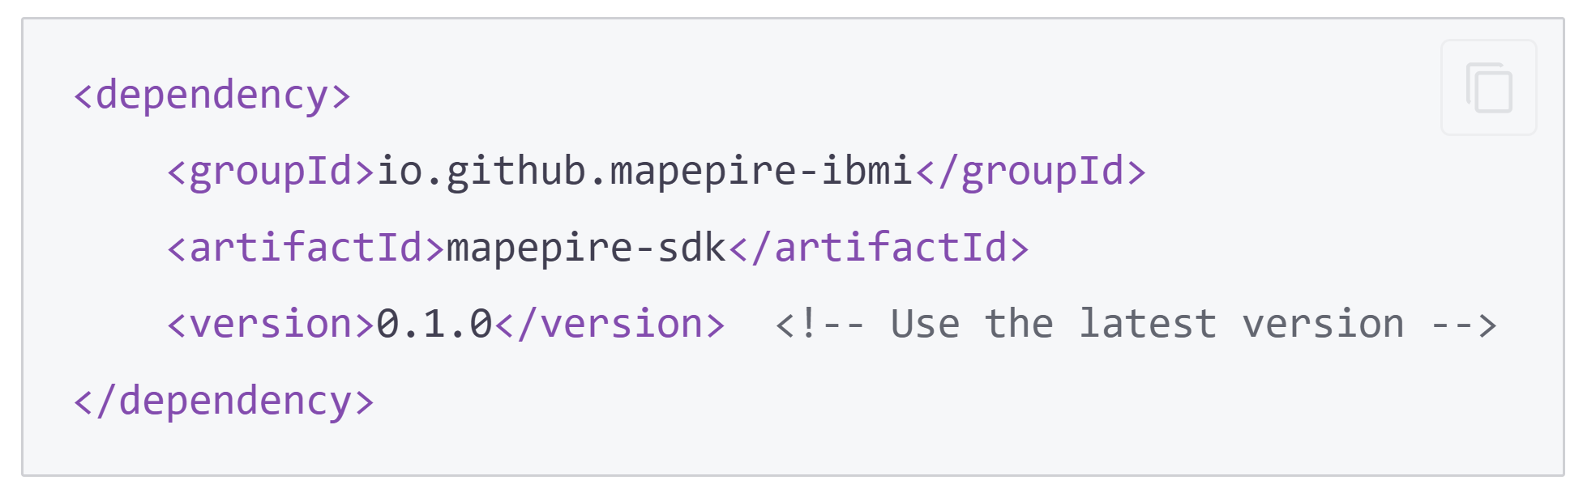
Mapepire-java client setup
Requirements
Java 8 or later
Installation
Add mapepire-sdk as a dependency (check for latest version on Maven Central Repository)
Links
Usage Docs: https://mapepire-ibmi.github.io/guides/usage/java/
GitHub Repository: https://github.com/Mapepire-IBMi/mapepire-java

Slide 28
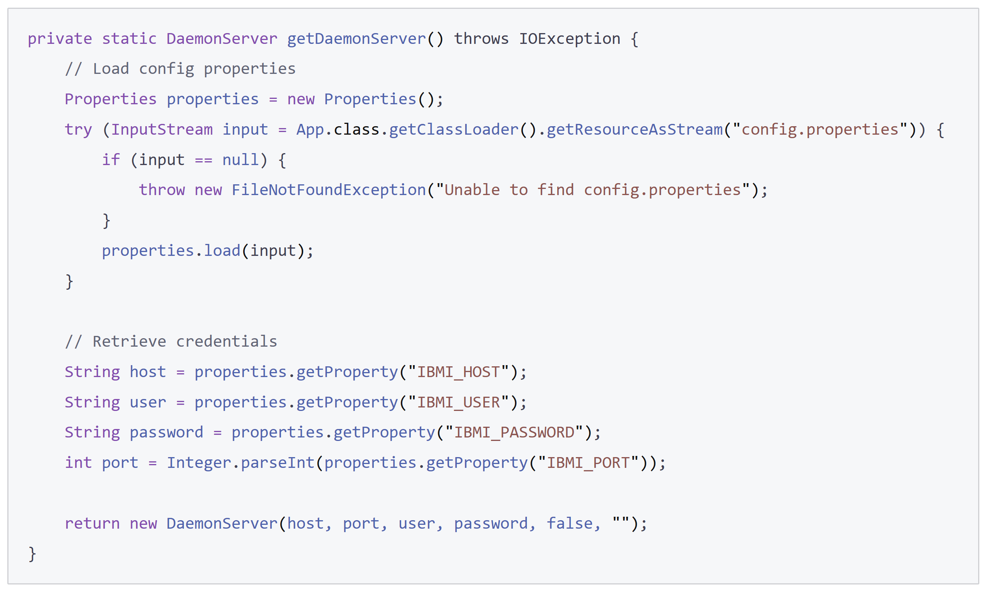
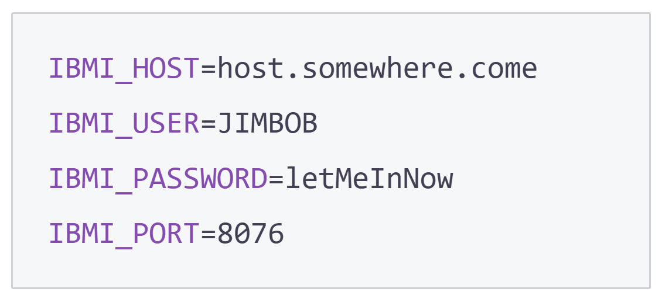
Setup credentials
Create a helper function to construct a DaemonServer object
Create a config.properties file with your IBM i connection

Slide 29

Now it’s time to write some queries!
Here is some of the functionality:
Connect to the database
Run SQL statements
Paginate results
Run prepared statements
Run a batch of statements
Create and execute procedures
Run CL commands
Run SQL statements via a pool
Leverage JDBC options
Manage the server and JTOpen trace data
Get Mapepire version
Close a connection
… and much more!

Slide 30
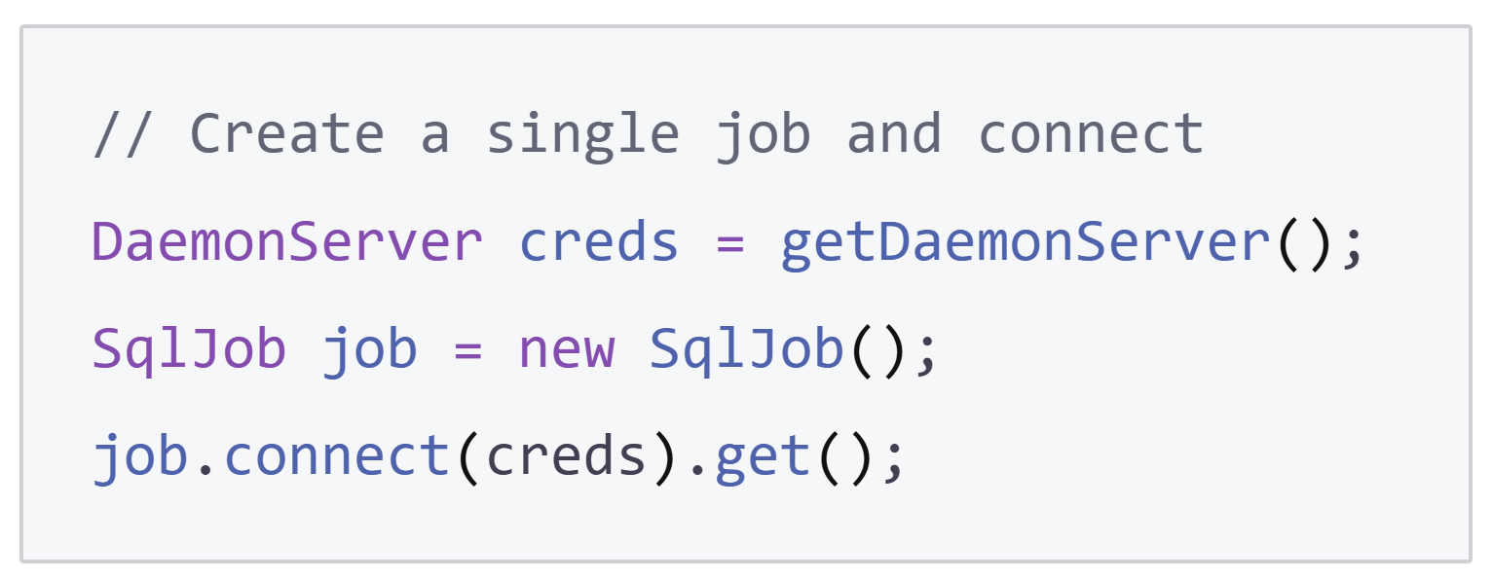
Connecting to the database

Slide 31
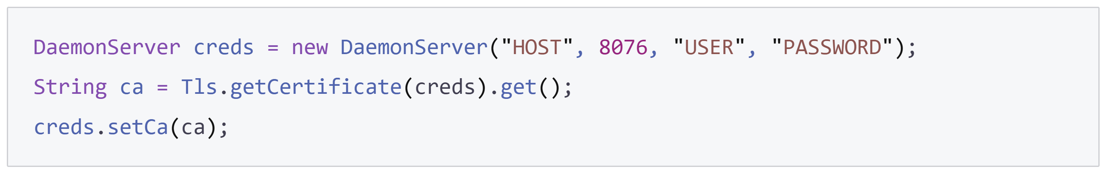
Certificate configuration
Allow all certificates
Validate self-signed certificate
Validate certificate signed by a recognized CA

Slide 32
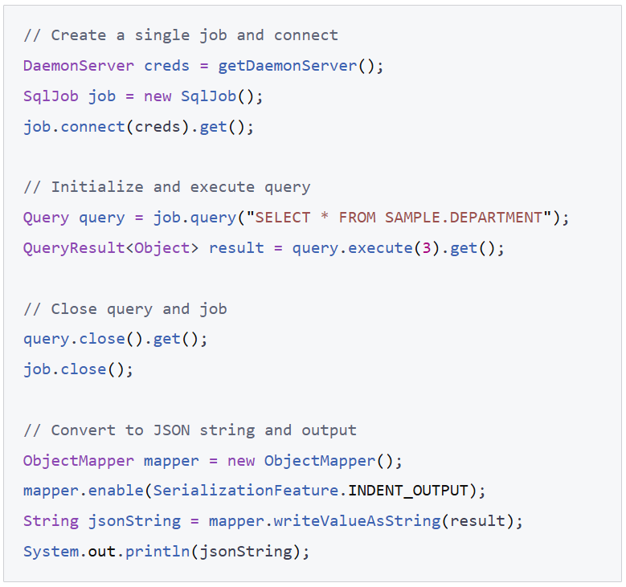
Executing a query

Slide 33
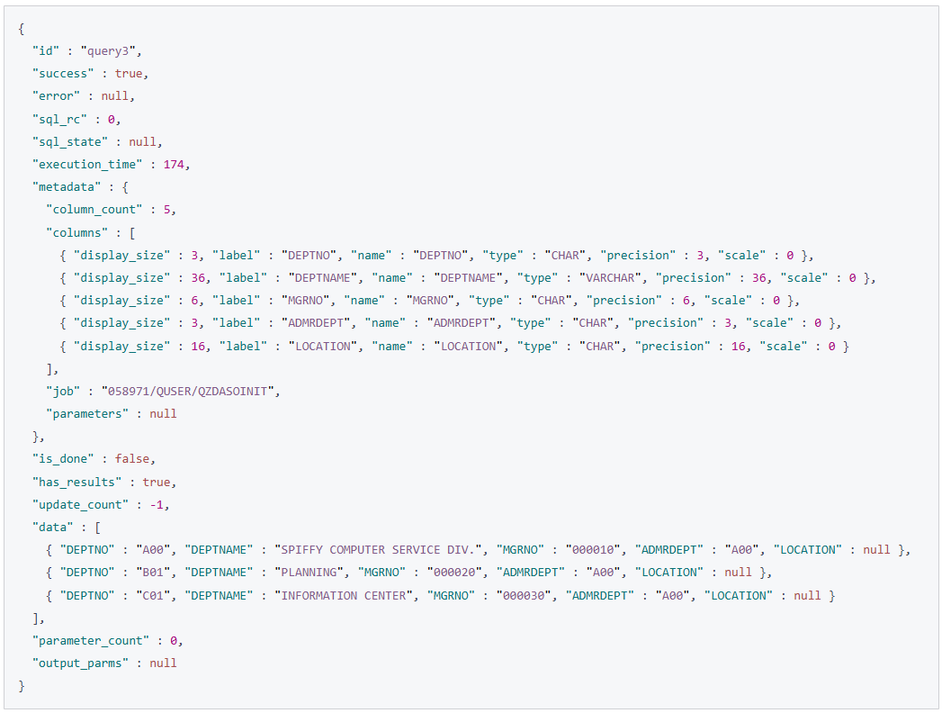
Query result structure

Slide 34
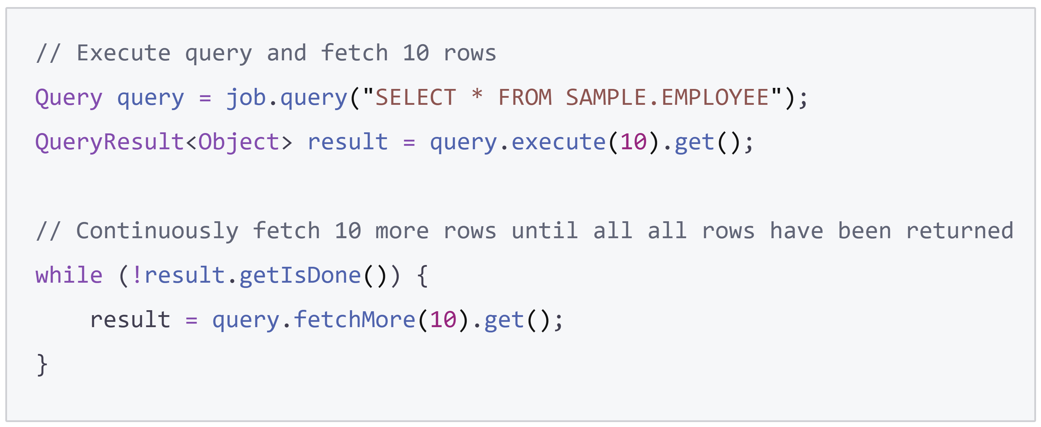
Paginating results

Slide 35
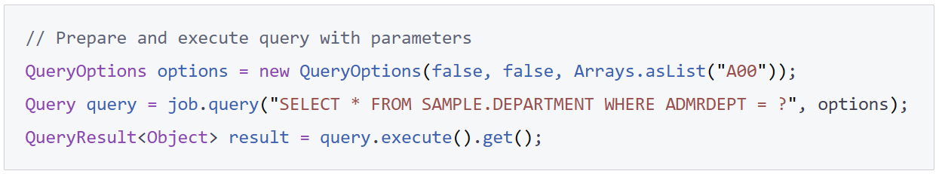
Executing a prepared statement

Slide 36
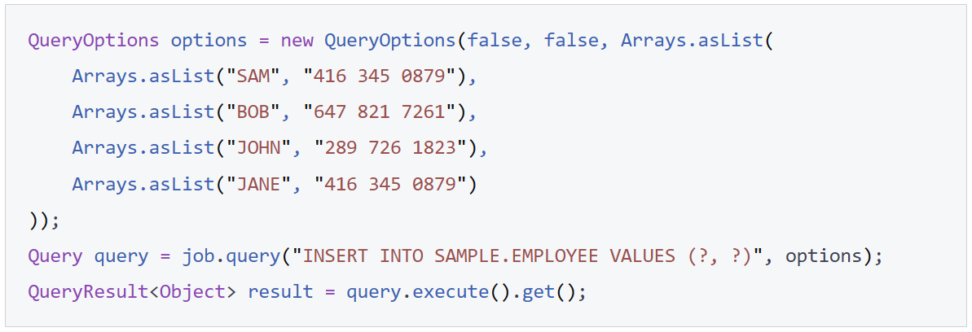
Executing a batch of statements

Slide 37
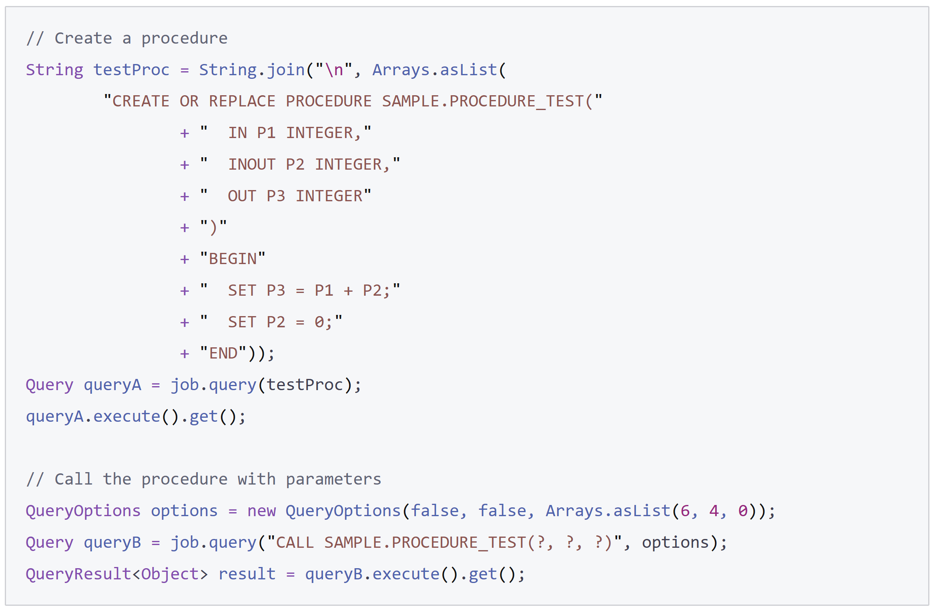
Creating and executing a procedure

Slide 38
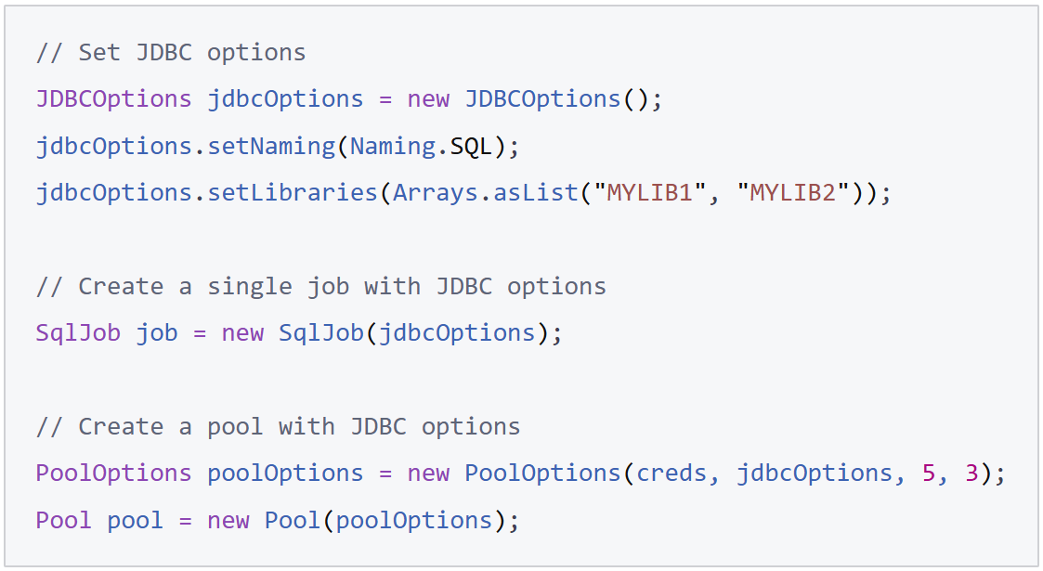
Leverage JDBC options

Slide 39
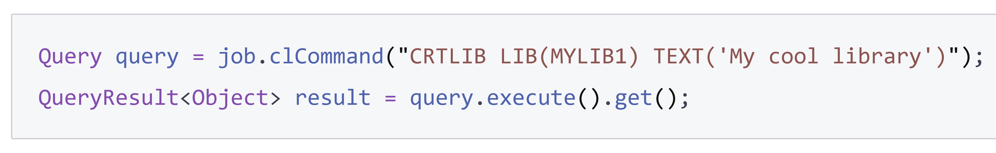
Executing a CL command

Slide 40
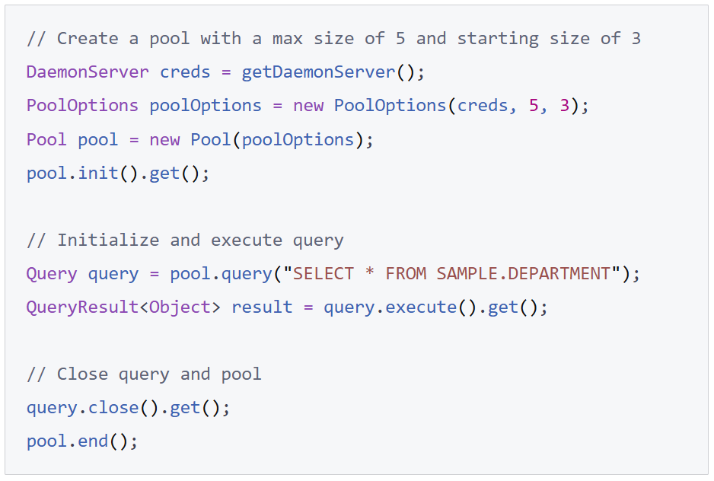
Executing statements using a pool

Slide 41
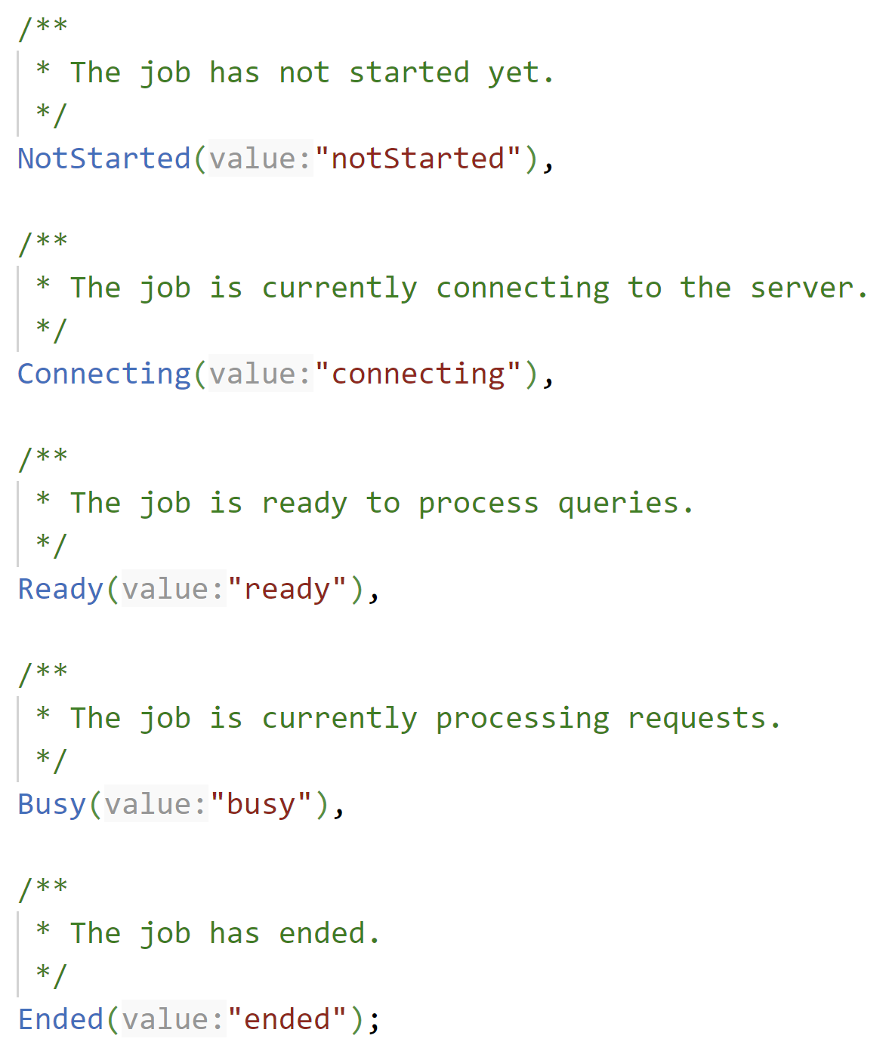
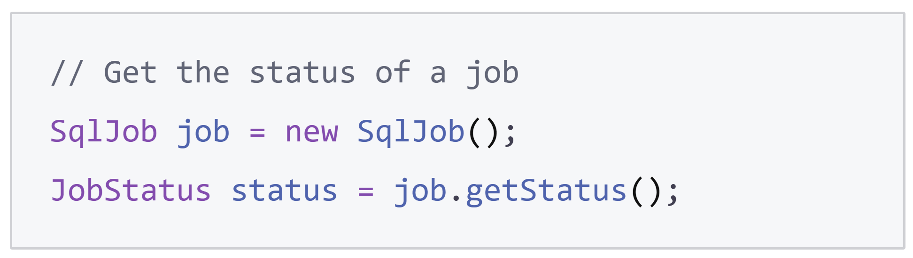
Retrieve the status of an SQL job

Slide 42
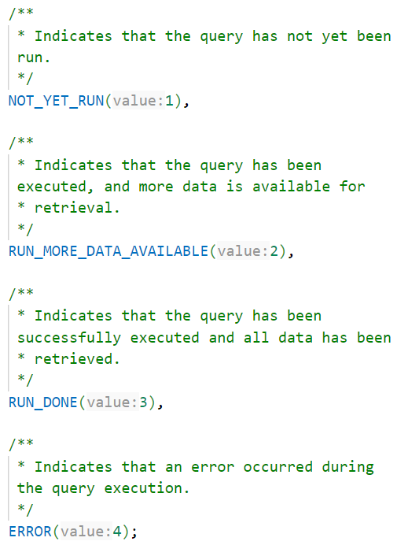
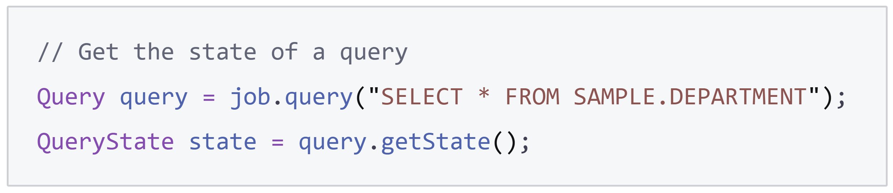
Retrieve the state of a query

Slide 43
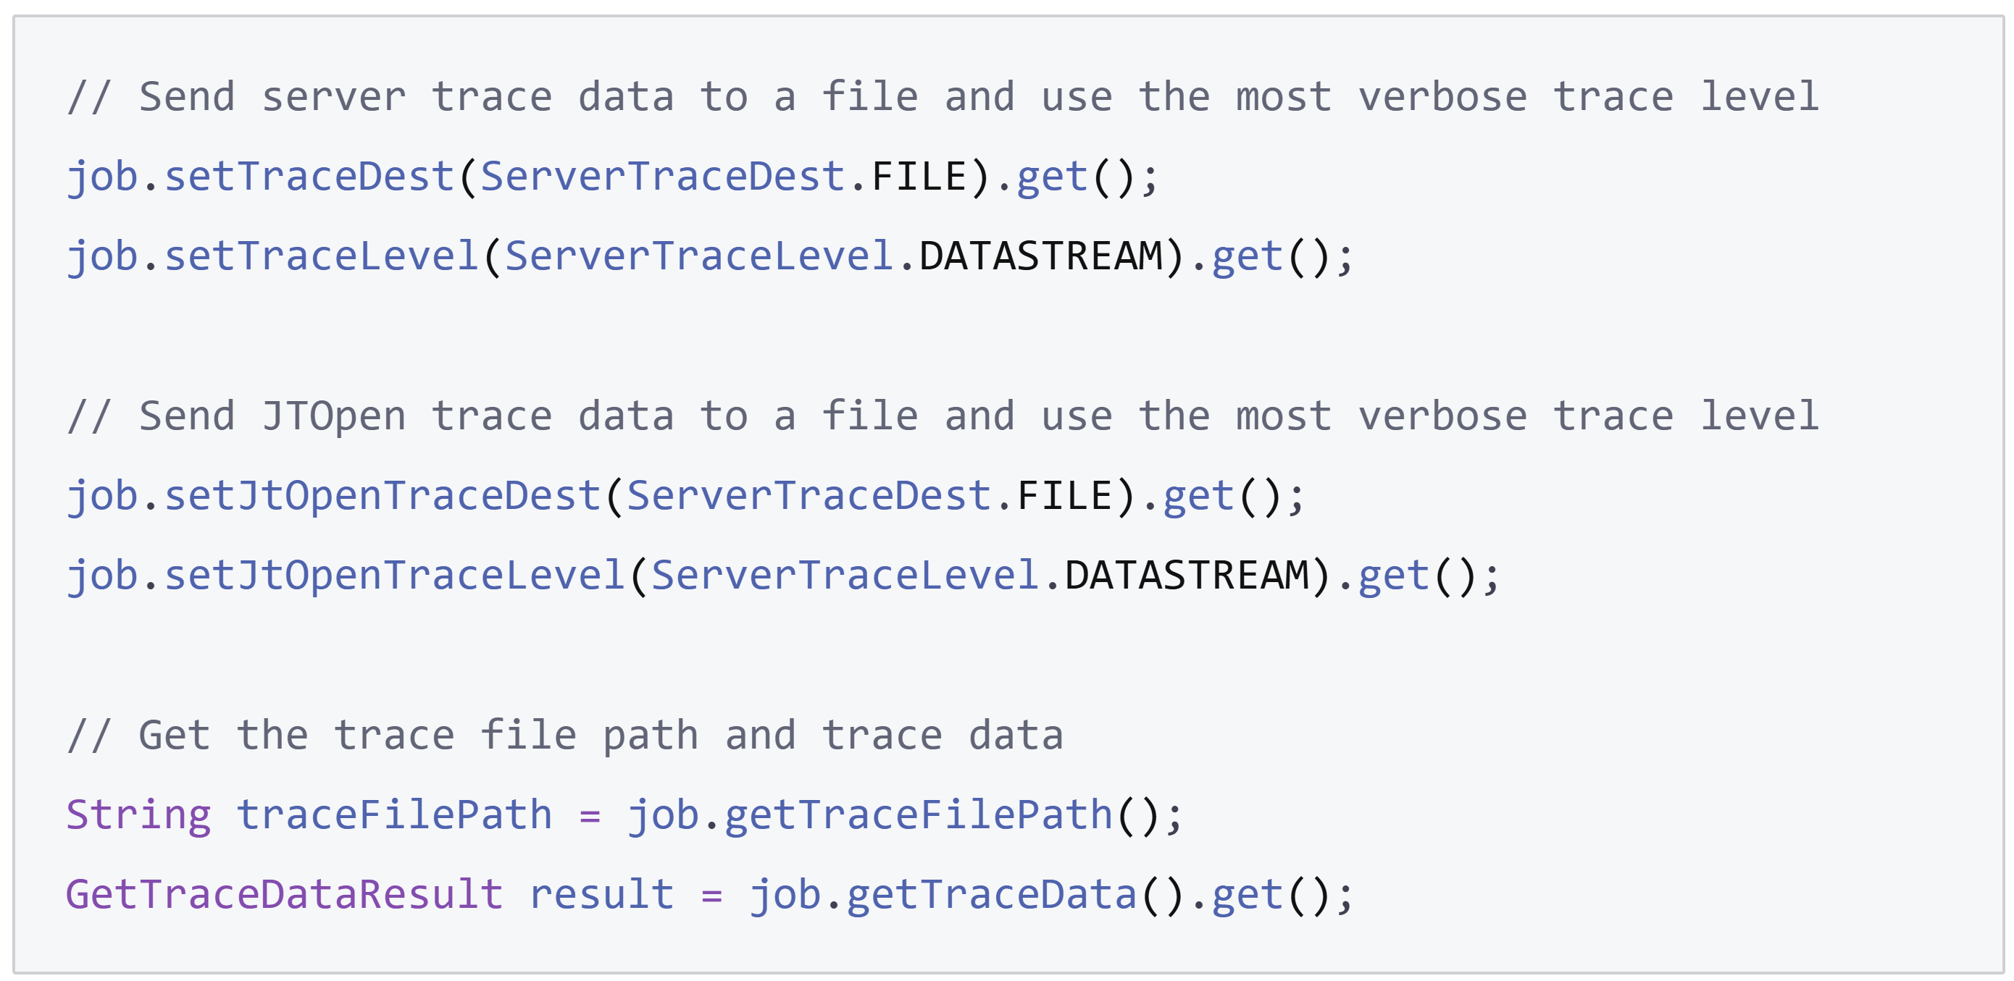
Set trace configuration and retrieve trace data

Slide 44
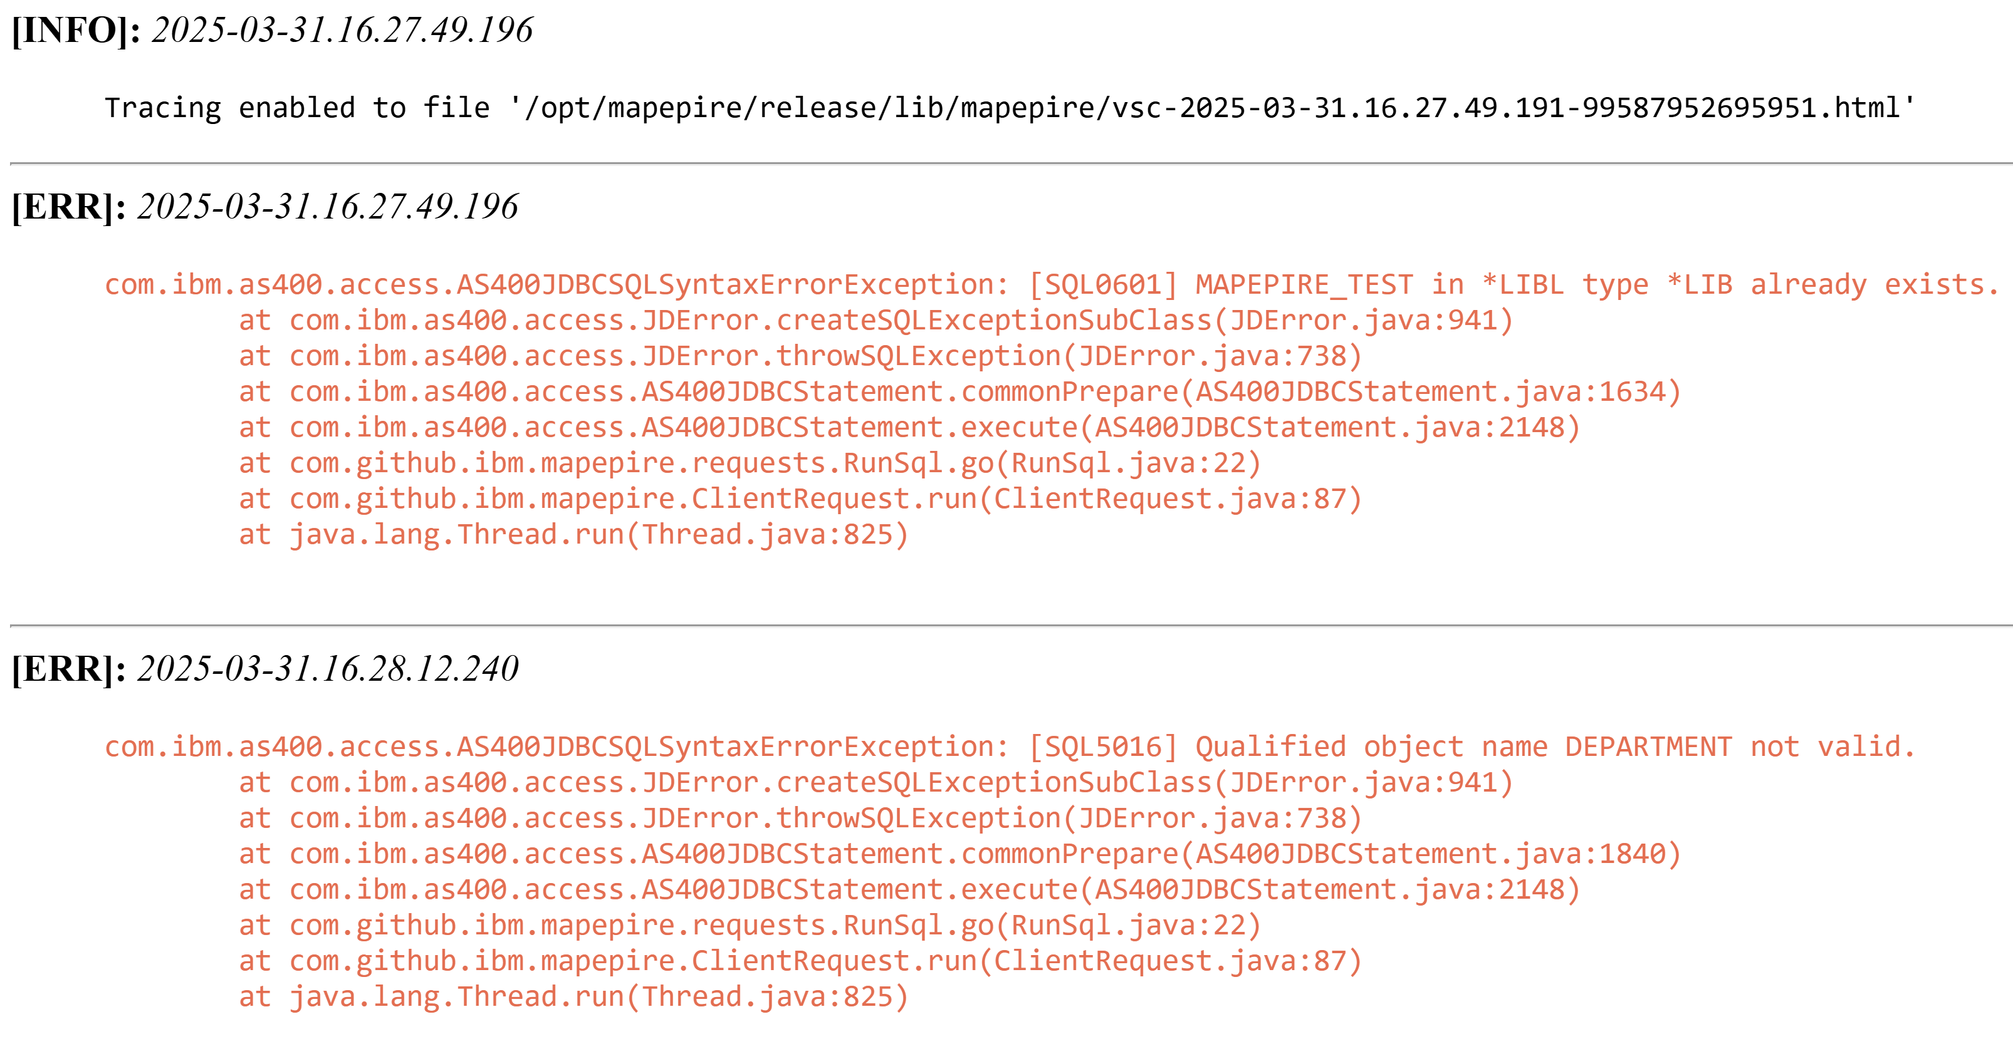
Server trace data

Slide 45
Consistent SDK behavior access languages
Guided by a unified reference architecture
https://mapepire-ibmi.github.io/reference/maintenance/referencearchitecture/
Similar experiences
Class names
Method names
Throwable types
Input parameters
Configuration options

Slide 46
Node.js vs Java Implementation
Node.js
Java
// Initialize credentials
const creds: DaemonServer = { host: "HOST", port: 8076, user: "USER", password: "PASSWORD", rejectUnauthorized: true, ca: "CA" }
// Establish connection
const job = new SQLJob();
await job.connect(creds);
// Initialize and execute query
const query = job.query("SELECT * FROM SAMPLE.DEPARTMENT");
const result = await query.execute(3);
// Convert to JSON string and output
console.log(JSON.stringify(result));
// Initialize credentials
DaemonServer creds = new DaemonServer("HOST", 8085, "USER", "PASSWORD", true, "CA");
// Establish connection
SqlJob job = new SqlJob();
job.connect(creds).get();
// Initialize and execute query
Query query = job.query("SELECT * FROM SAMPLE.DEPARTMENT");
QueryResult<Object> result = query.execute(3).get();
// Convert to JSON string and output
ObjectMapper mapper = new ObjectMapper();
mapper.enable(SerializationFeature.INDENT_OUTPUT);
String jsonString = mapper.writeValueAsString(result);
System.out.println(jsonString);

Slide 47
Demo

Slide 48
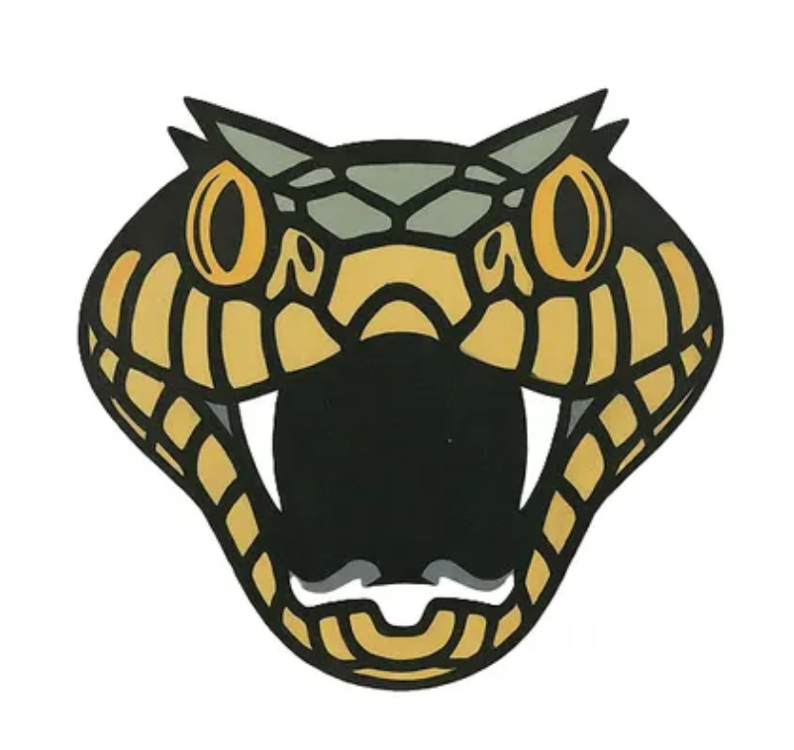
Takeaways
Config
Great performance
Always encrypted
Any Hardware
Any Language
Flexibility

Slide 49
Any Questions?

Slide 50
Important Links
Mapepire
Documentation https://mapepire-ibmi.github.io/
Server Component https://github.com/Mapepire-IBMi/mapepire-server
Node.js Client
GitHub Repository https://github.com/Mapepire-IBMi/mapepire-js
NPM https://www.npmjs.com/package/@ibm/mapepire-js
Java Client
GitHub Repository https://github.com/Mapepire-IBMi/mapepire-java
Maven Central https://central.sonatype.com/artifact/io.github.mapepire-ibmi/mapepire-sdk
Python Client
GitHub Repository https://github.com/Mapepire-IBMi/mapepire-python
PyPi https://pypi.org/project/mapepire-python/
Service Commander
GitHub Repository https://github.com/ThePrez/ServiceCommander-IBMi

Slide 51

Sanjula Ganepola, Jonathan Zak - Forget ODBC! Here’s a New Db2 Connector
Please take the last minute of this session to complete the evaluation. A direct link to the evaluation can be found using the QR code to the right.

